Slide 1
Final Presentation - Ayush Bhupal 5th August, 2022

Slide 2
Project Title:
Pricing of Equity Options/Call Spreads/Options Strategies using Dupire/Heston models for volatility calibration

Slide 3

Table of Contents
01 | Market Data
02 | Dupire Implementation
 | Introduction
 | Steps
 | Plots
 | Key Learnings
03 | Heston Implementation
 | Introduction
 | Steps
 | Plots
 | Key Learnings
04 | Pricing
 | Plots

Slide 4
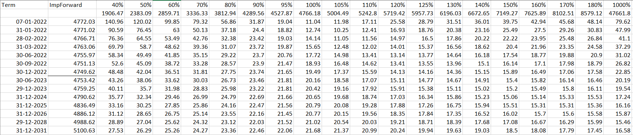
Market Data
Underlying Asset – S&P 500, Trade date : Fri, 31 Dec 2021, Spot:4766.18, Currency : USD, Exchange : CBOE

Slide 5
Dupire Implementation

Slide 6
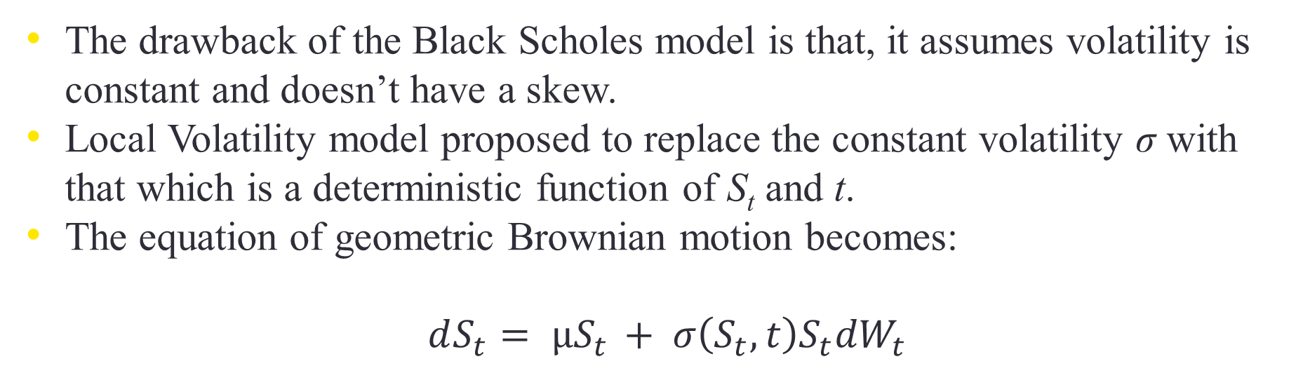
Introduction to Local Volatility
The drawback of the Black Scholes model is that, it assumes volatility is constant and doesn’t have a skew.
Local Volatility model proposed to replace the constant volatility σ with that which is a deterministic function of S_{t} and t.
The equation of geometric Brownian motion becomes:
$$dS_{t}= µS_{t} + σ\left(S_{t}, t\right)S_{t}{dW}_{t}$$

Slide 7
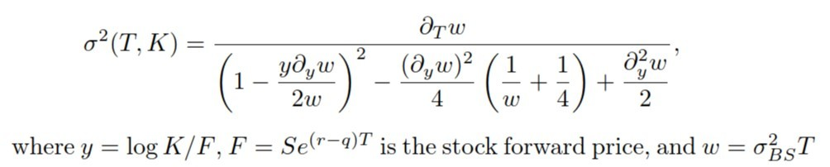
Local Volatility
The formula for local volatility from implied volatility is derived from GBM, Ito’s lemma and Dupire’s equation.

Slide 8
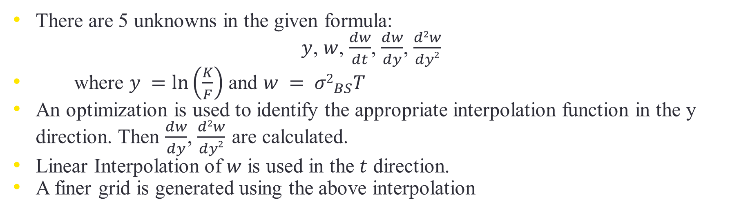
The Unknown Variables
There are 5 unknowns in the given formula:
$y$, $w$, $\frac{dw}{dt}$, $\frac{dw}{dy}$, $\frac{d2w}{dy2}$
where $y =\ln\left(\frac{K}{F}\right)$ and $w = {σ2}_{BS}T$
An optimization is used to identify the appropriate interpolation function in the y direction. Then $\frac{dw}{dy}$, $\frac{d2w}{dy2}$ are calculated.
Linear Interpolation of $w$ is used in the $t$ direction.
A finer grid is generated using the above interpolation

Slide 9
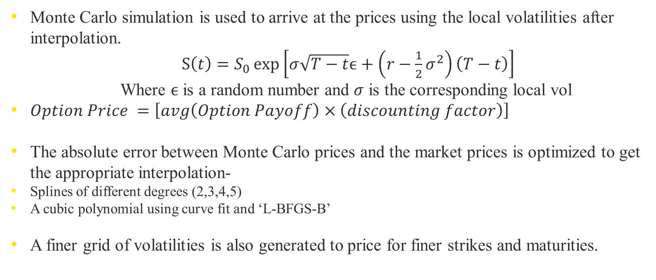
Steps
Monte Carlo simulation is used to arrive at the prices using the local volatilities after interpolation.
$S\left(t\right)=S_{0}\exp\left[σ\sqrt{T−t}ϵ+\left(r−\frac{1}{2}σ^{2}\right)\left(T−t\right)\right]$
Where $ϵ$ is a random number and $σ$ is the corresponding local vol
$Option Price =\left[avg\left(Option Payoff\right)×\left(discounting factor\right)\right]$
The absolute error between Monte Carlo prices and the market prices is optimized to get the appropriate interpolation-
Splines of different degrees (2,3,4,5)
A cubic polynomial using curve fit and ‘L-BFGS-B’
A finer grid of volatilities is also generated to price for finer strikes and maturities.

Slide 10
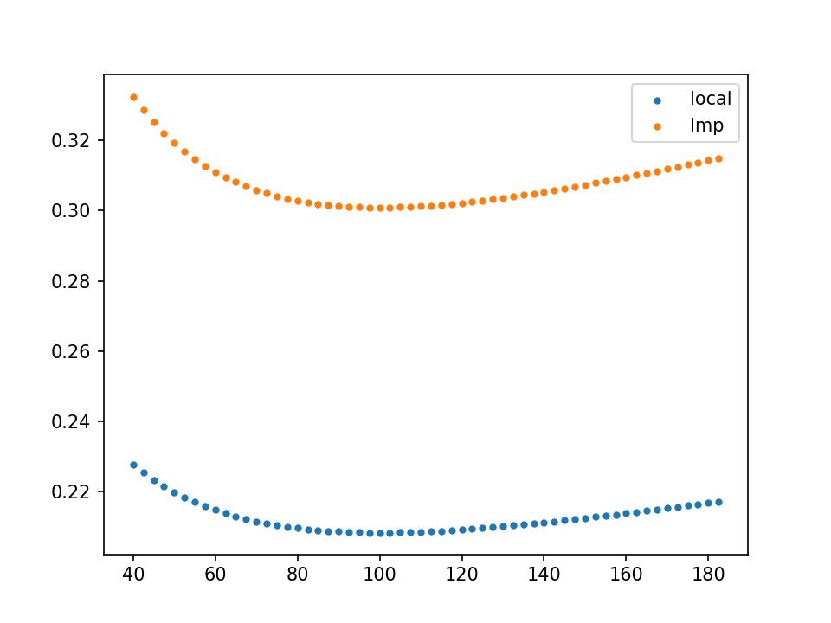
Smile for a polynomial fit of the implied vols

Slide 11
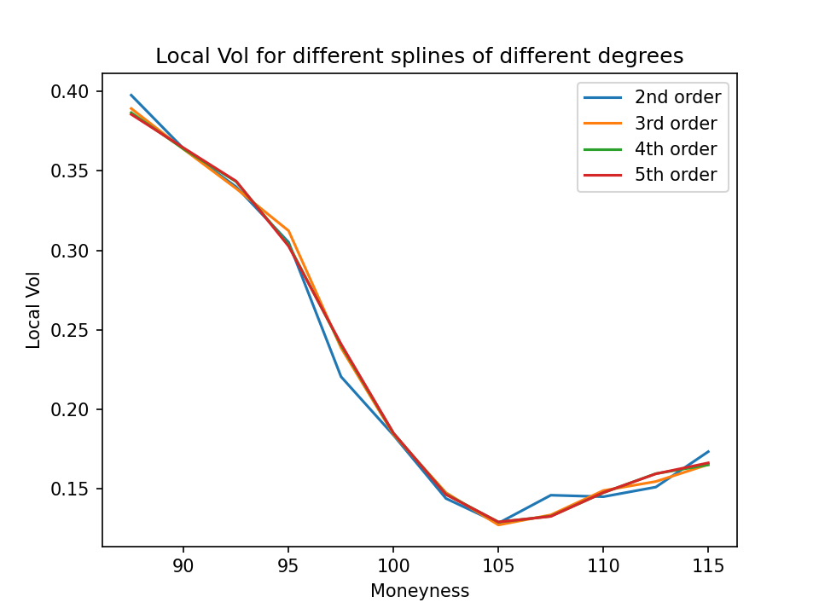
Checking the fit around ATM

Slide 12
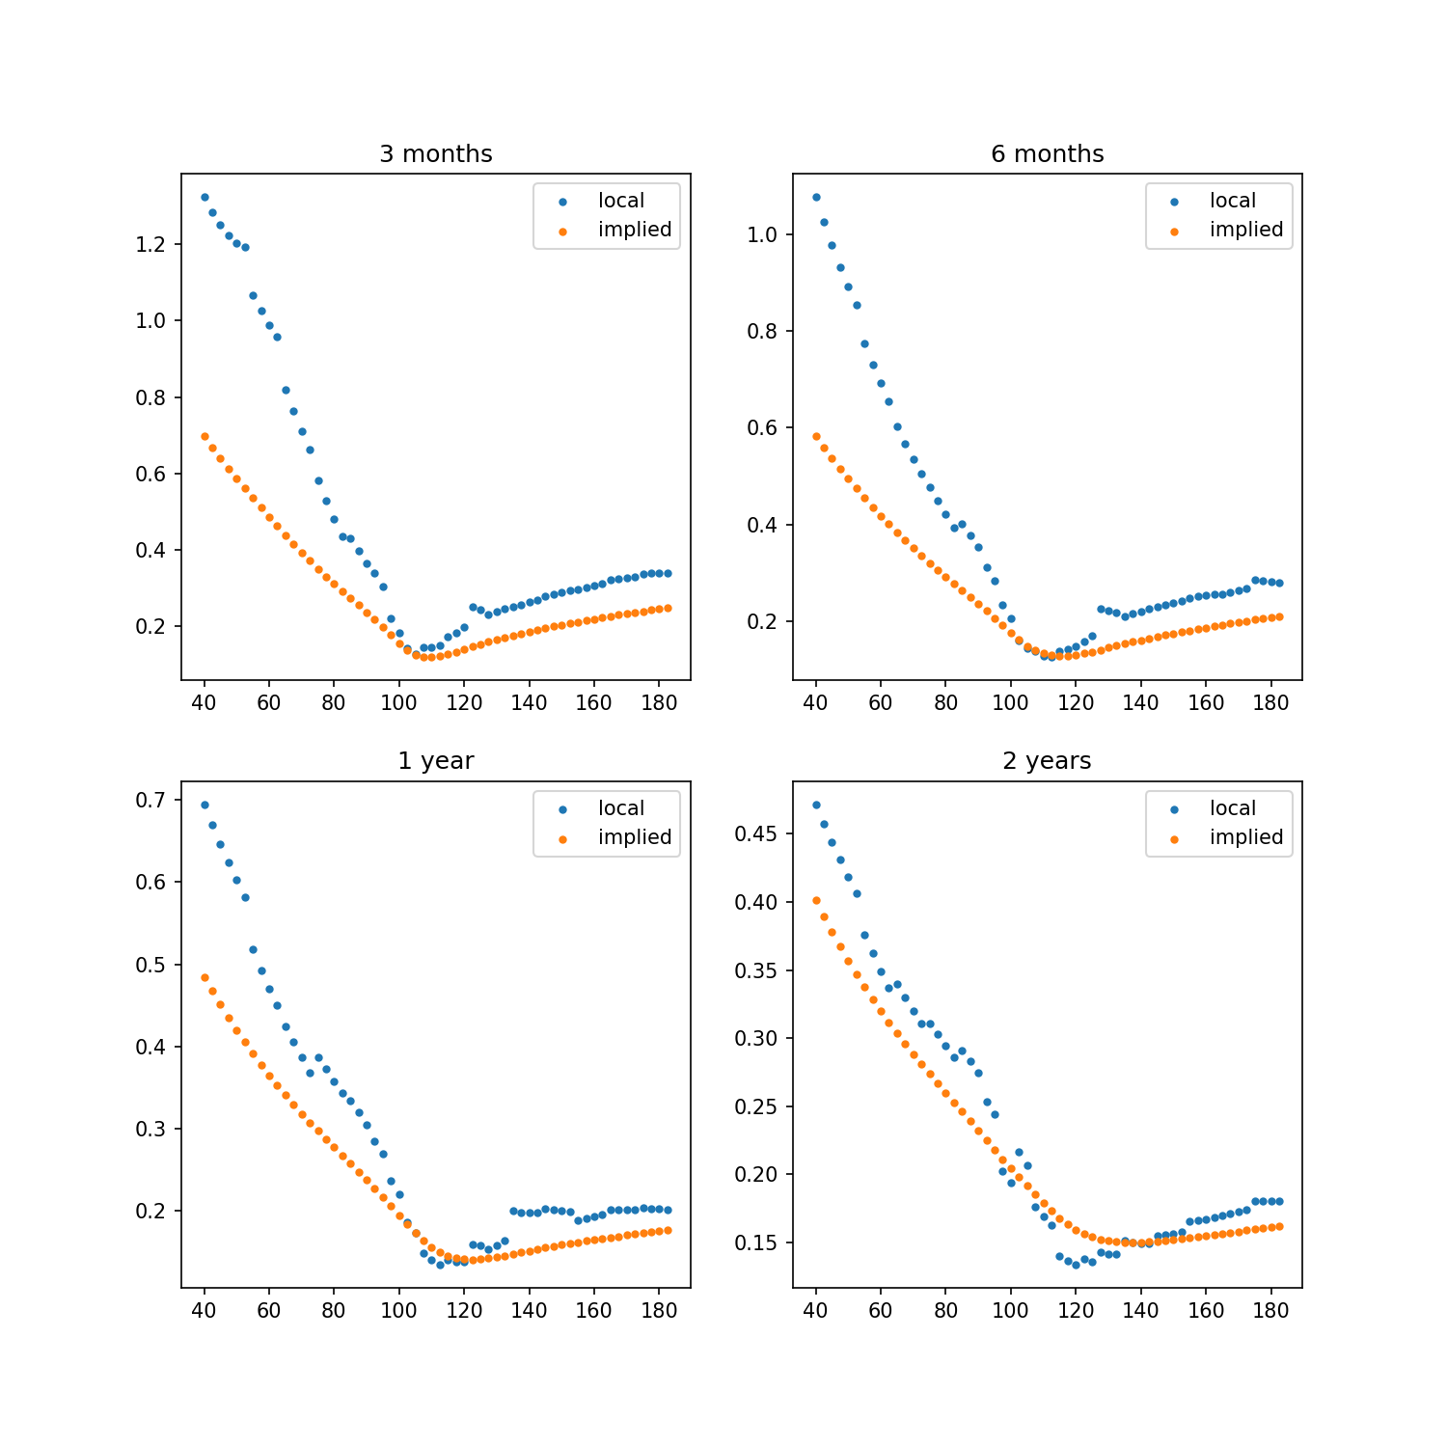
Best results are obtained with a 2nd degree spline with zero smoothing
The plots are for Volatility vs Strikes (Moneyness) for different maturities

Slide 14
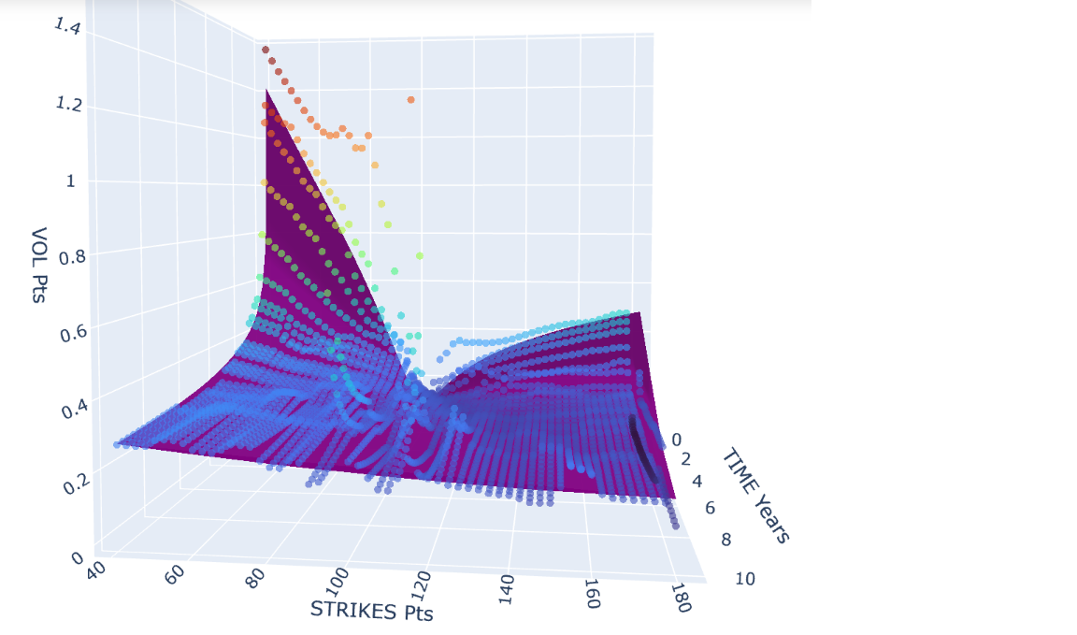
Implied Volatility Mesh vs Local Volatility Markers

Slide 15
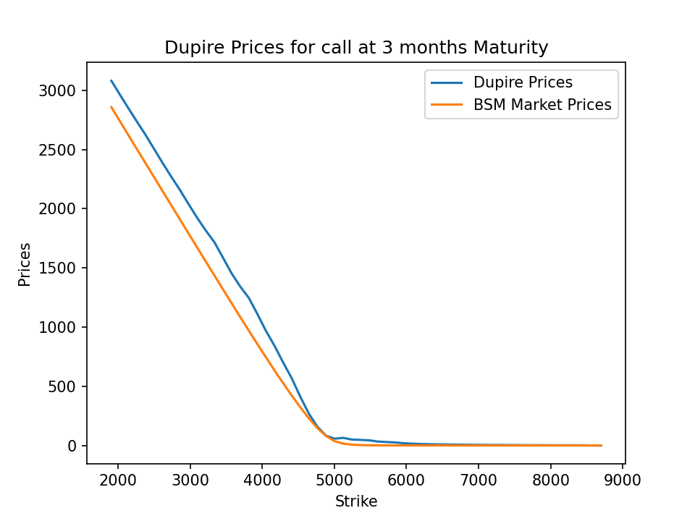

Slide 16
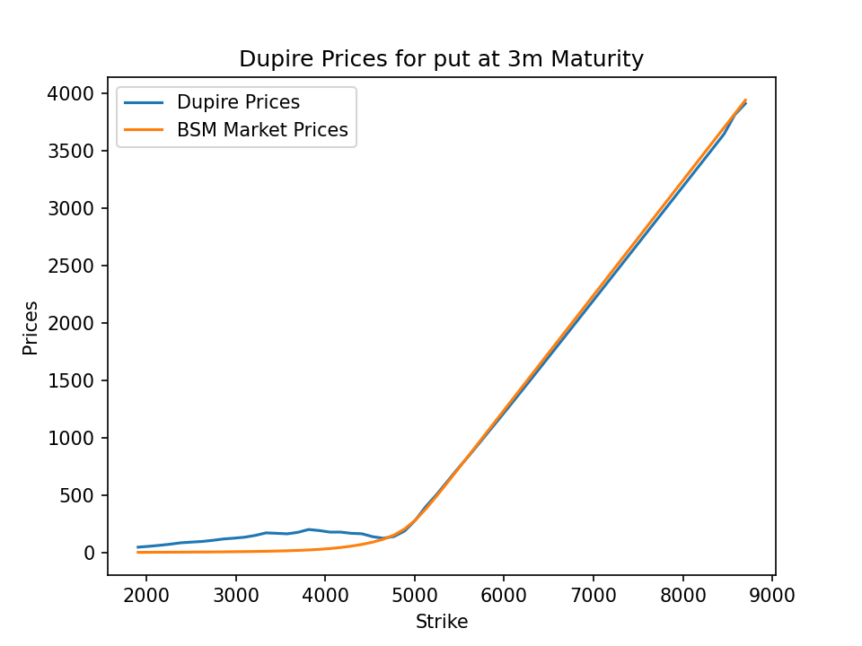

Slide 17
Key Learnings
Direct extension of BSM – Sensitive to changes in Implied Volatility - Assumes markets are complete
Simple and exact calibration since there is an analytical formula
Price paths during Monte Carlo Simulation can be used for pricing exotic options
Constant Vols towards extreme strikes, since there are no liquid instruments
Assumes forward skews to be flat – Overestimates actual prices – Should only be used for hedging
Difficult to incorporate future dynamics of the volatility smile

Slide 18
Heston Implementation

Slide 19
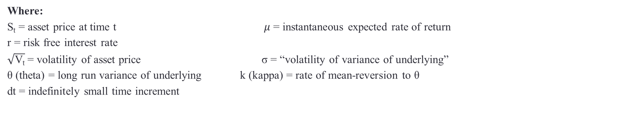
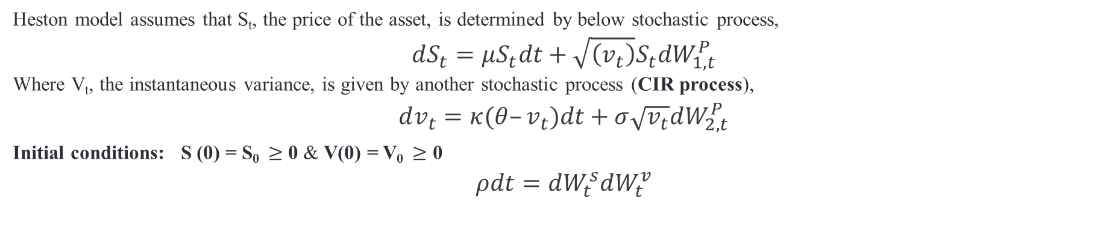
Heston model
Heston model assumes that S_{t}, the price of the asset, is determined by below stochastic process,
$$dS_{t}=μS_{t}dt+\sqrt{\left(v_{t}\right)}S_{t}dW_{1,t}^{P}$$
Where V_{t}, the instantaneous variance, is given by another stochastic process (CIR process),
$$dv_{t}=κ(θ–v_{t})dt+σ\sqrt{v_{t}}dW_{2,t}^{P}$$
Initial conditions: S (0) = S₀ $≥$ 0 & V(0) = V₀ $≥$ 0
$$ρdt=dW_{t}^{s}dW_{t}^{v}$$
Where:
S_{t} = asset price at time t $μ$ = instantaneous expected rate of return
r = risk free interest rate
$\sqrt{\text{V}\text{t}}$= volatility of asset price σ = “volatility of variance of underlying”
θ (theta) = long run variance of underlying k (kappa) = rate of mean-reversion to θ
dt = indefinitely small time increment
Reasons for choosing Heston model in the class of stochastic volatility models are:
gives closed form solution for pricing plain vanilla European options.
Conveys that the volatility is mean-reverting
factors in a possible correlation between a stock's price and its volatility.

Slide 20
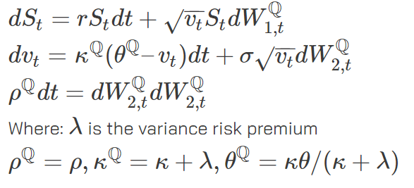
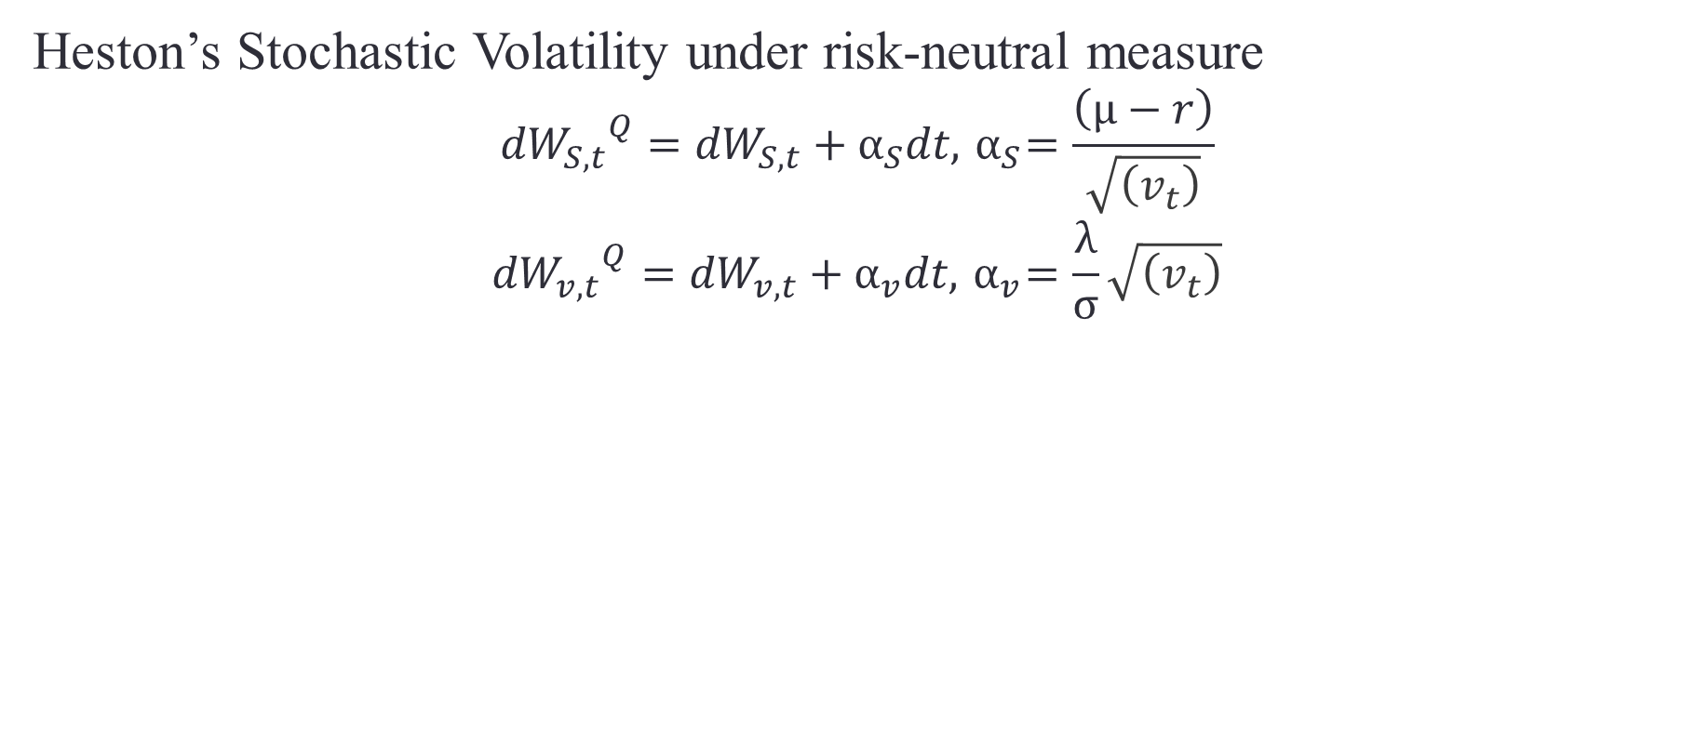
Solving by Characteristic Functions under risk neutral measure
Heston’s Stochastic Volatility under risk-neutral measure
$${{dW}_{S,t}}^{Q}={dW}_{S,t}+α_{S}dt,{ α}_{S}=\frac{\left(μ−r\right)}{\sqrt{\left(v_{t}\right)}}$$
$${{dW}_{v,t}}^{Q}={dW}_{v,t}+α_{v}dt,{ α}_{v}=\frac{λ}{σ}\sqrt{\left(v_{t}\right)}$$
r = risk free interest rate

Slide 21
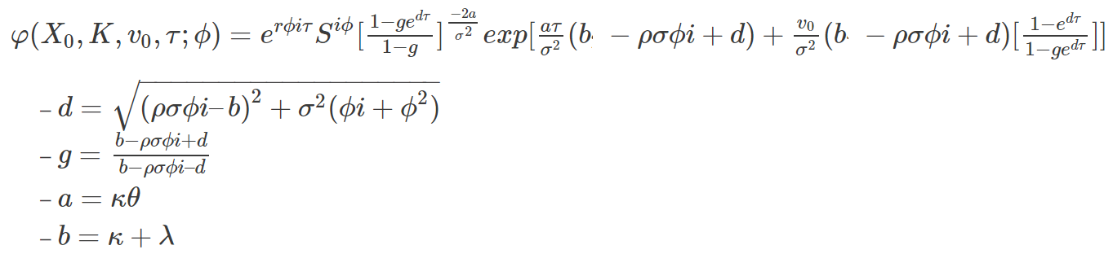
Solving by Characteristic Functions under risk neutral measure
Option Price -

Slide 22
Parameter values were not converging for different optimization techniques like SLSQP, L-BFGS-B and COBYLA

Slide 23
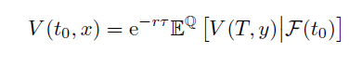
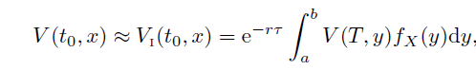
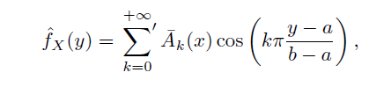
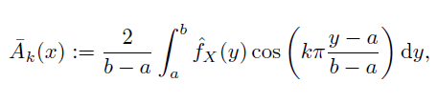
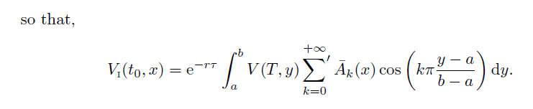
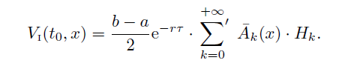
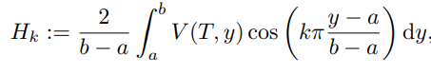
Heston Pricing function – COS Method
The value of a plain vanilla option is given by:
Since probability density function, f_{X}(y) is not known whereas the characteristic function is, the density is approximated by its Fourier cosine expansion, in y
With,
So that,
where,
Transformed an integral of the product of two real functions into a product of their fourier cosine series coefficients

Slide 24
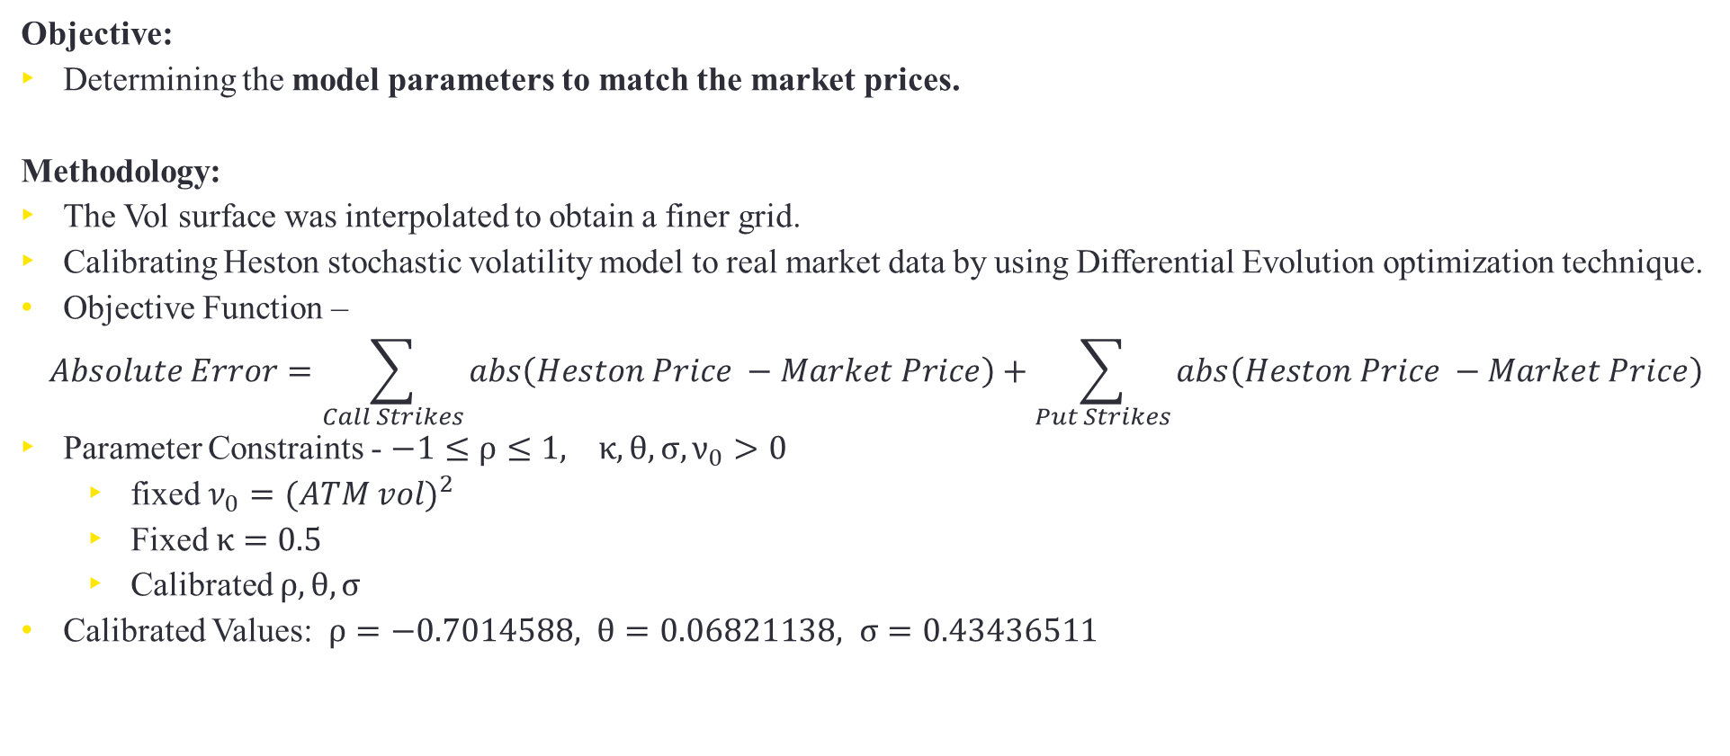
Steps
Objective:
Determining the model parameters to match the market prices.
Methodology:
The Vol surface was interpolated to obtain a finer grid.
Calibrating Heston stochastic volatility model to real market data by using Differential Evolution optimization technique.
Objective Function –
$$Absolute Error=\sum_{Call Strikes}{abs\left(Heston Price −Market Price\right)}+\sum_{Put Strikes}{abs\left(Heston Price −Market Price\right)}$$
Parameter Constraints - $−1≤ρ≤1, κ,θ,σ,ν_{0}>0$
fixed $ν_{0}={(ATM vol)}^{2}$
Fixed $κ=0.5$
Calibrated $ρ, θ, σ$
Calibrated Values: $ρ=−0.7014588, θ=0.06821138, σ=0.43436511$

Slide 25
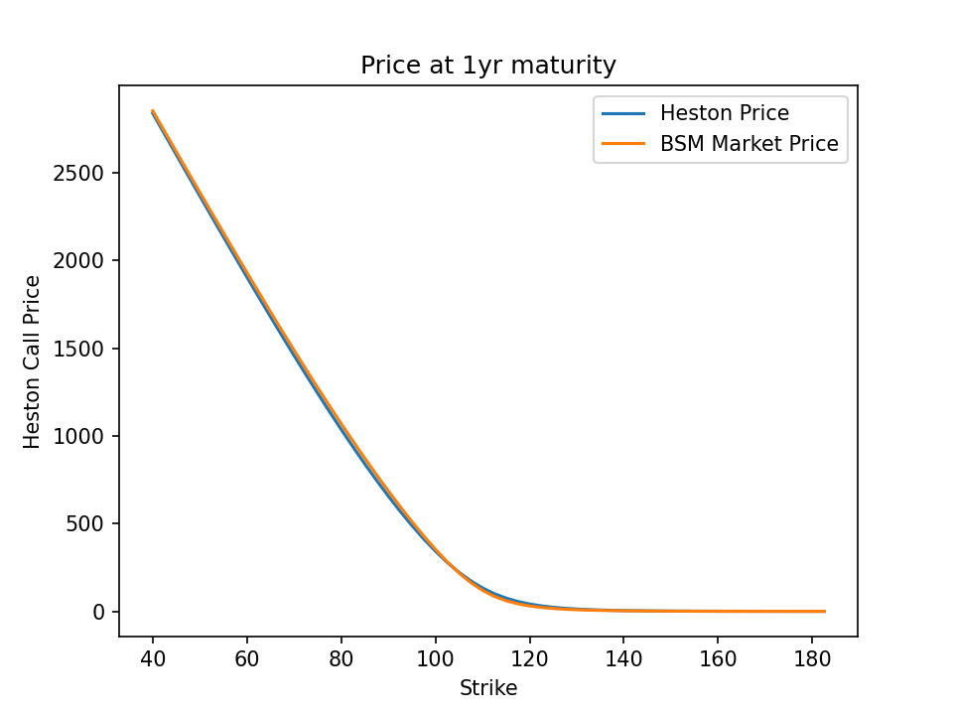

Slide 26
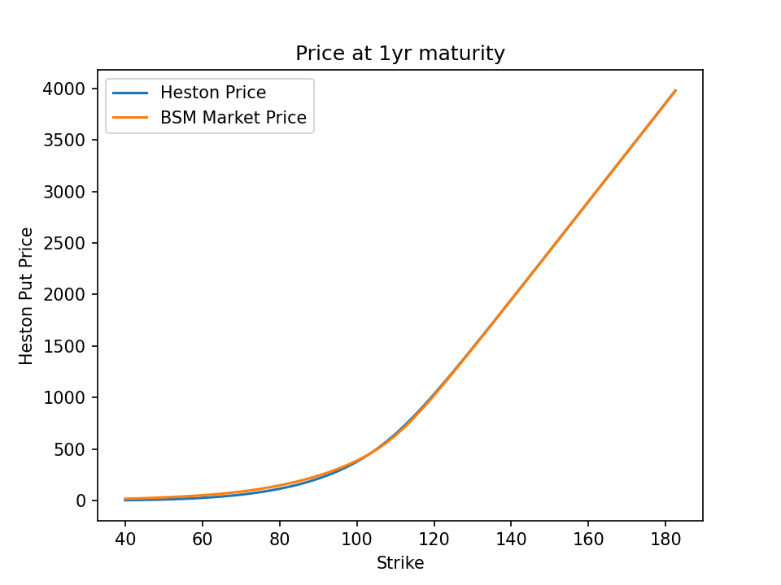

Slide 27
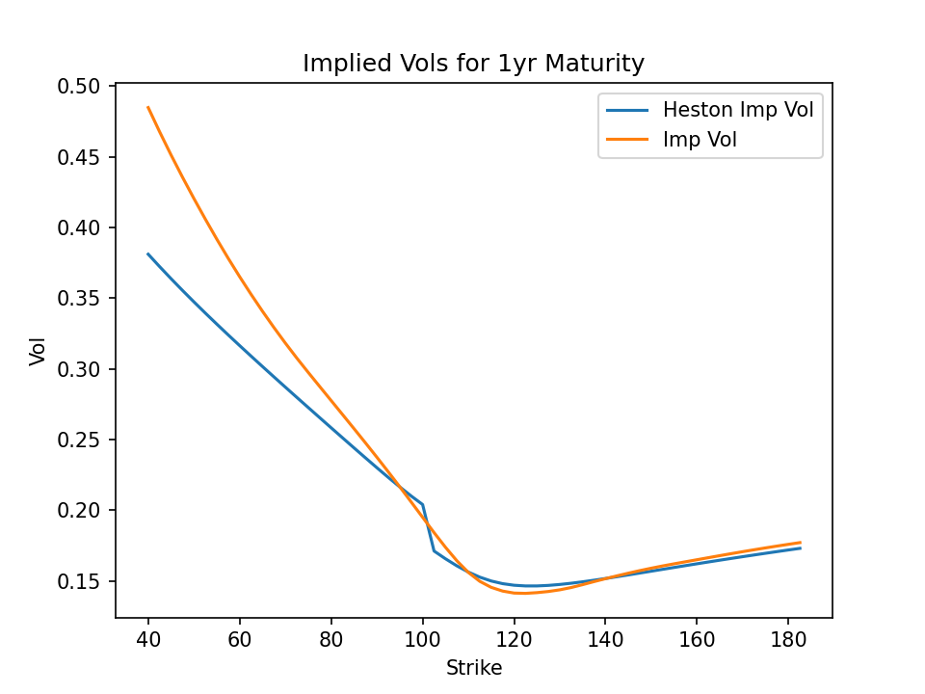

Slide 28
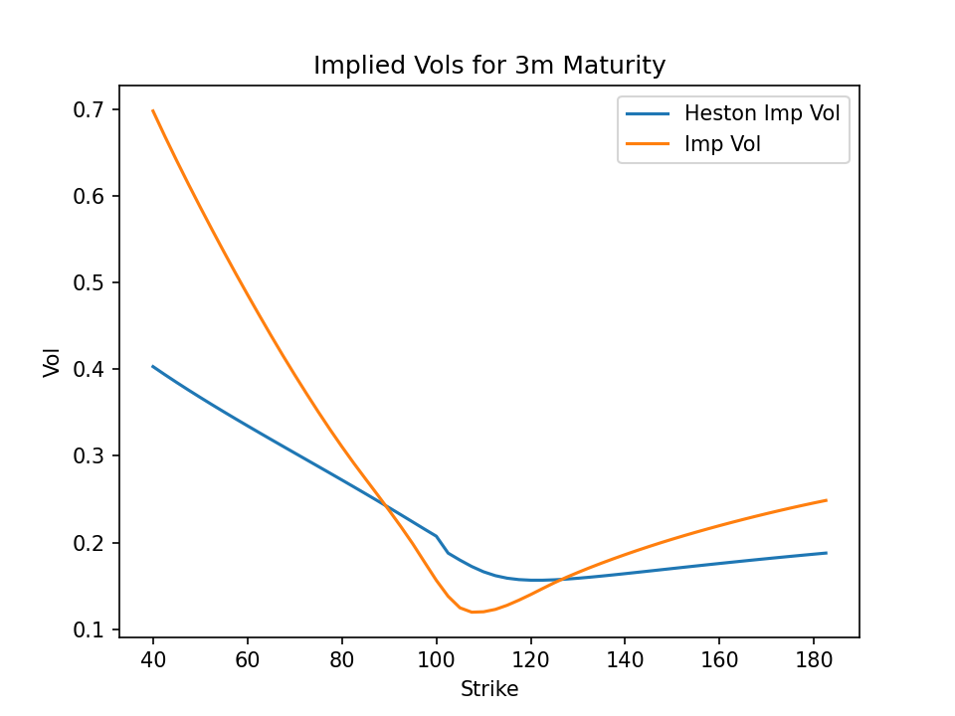

Slide 29
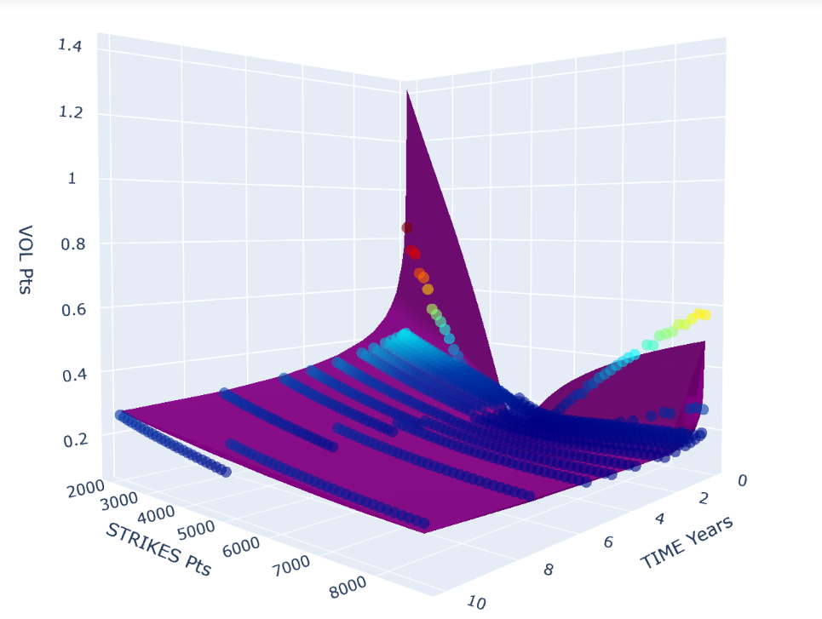
Implied Volatility Mesh vs Heston Implied Volatility Markers

Slide 30
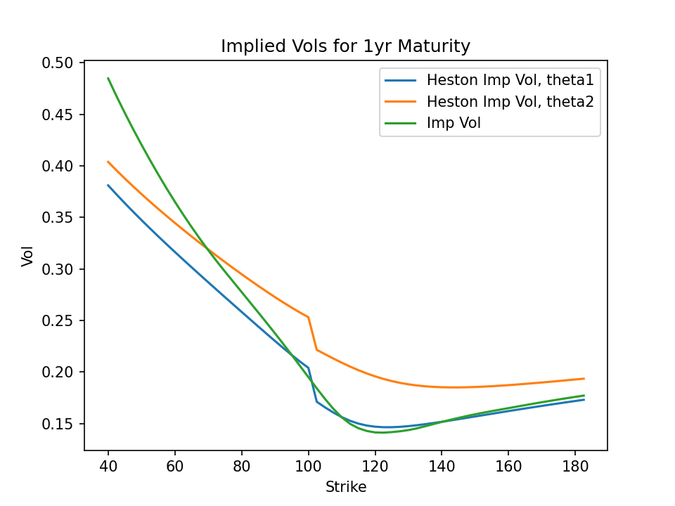
$θ_{2}=θ_{1}+0.$1

Slide 31
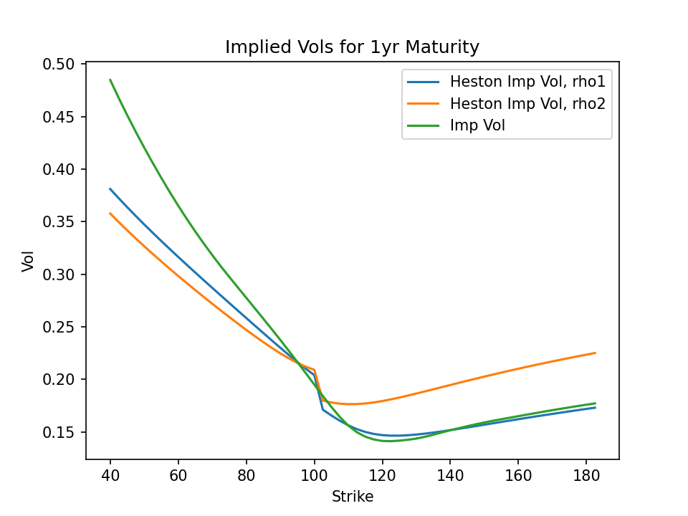

$$ρ_{2}=ρ_{1}+0.3$$
Controls skewness (asymmetry)

Slide 32
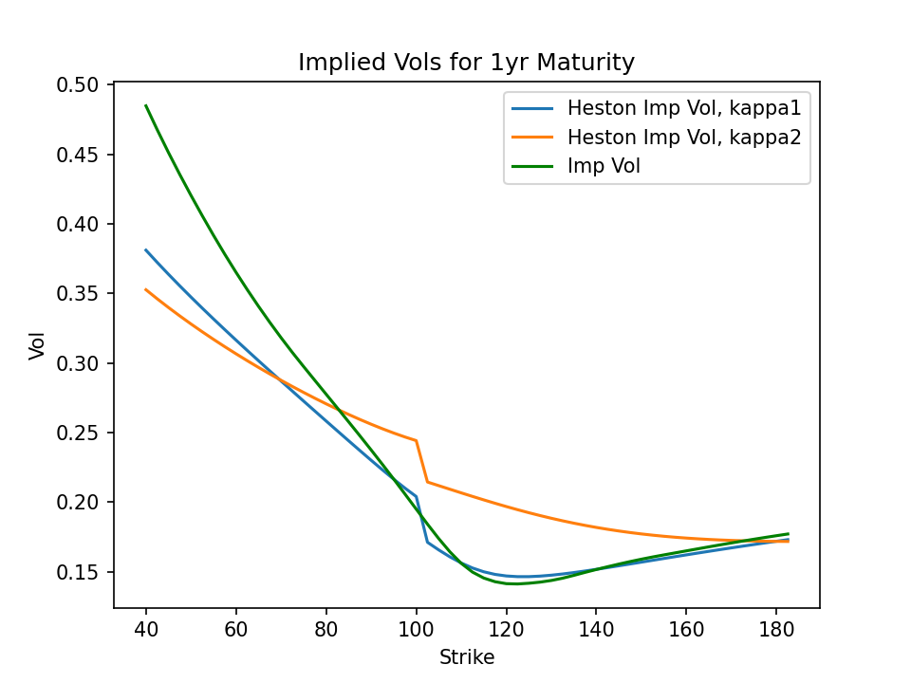

$$κ_{2}=κ_{1}+2$$
Controls curvature. Higher $κ$ corresponds to flatter vol structure

Slide 33
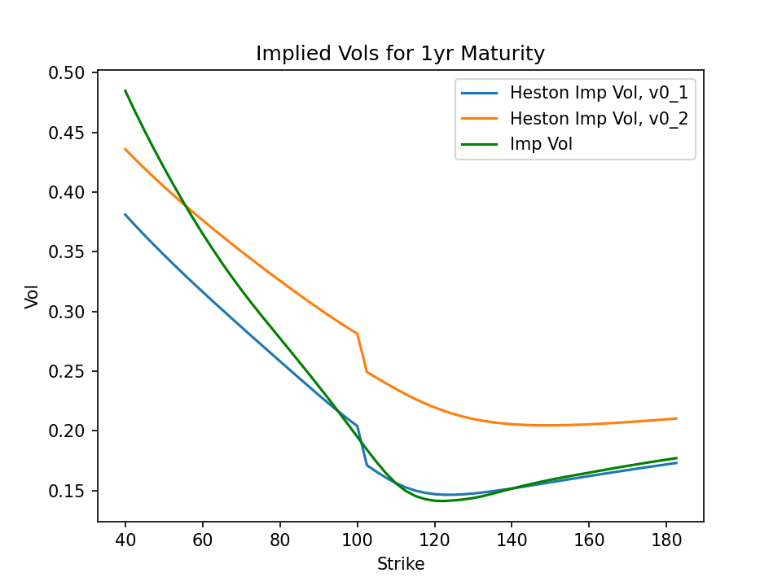
$${v_{0}}_{2}={v_{0}}_{1}+0.05$$

Slide 34
Key Learnings
Heston model does not require stock prices to follow a GBM
Because the market is incomplete, there exist infinitely many risk-neutral measures.
Highly sensitive to changes in the parameters
Tougher to calibrate – Heston model is known for being unstable
Provides a very close fit to the market prices if calibration is done carefully and correctly
Heston model suffers when it comes to predicting the option prices for short term options as the model fails to capture the high implied volatility

Slide 35
Pricing

Slide 36
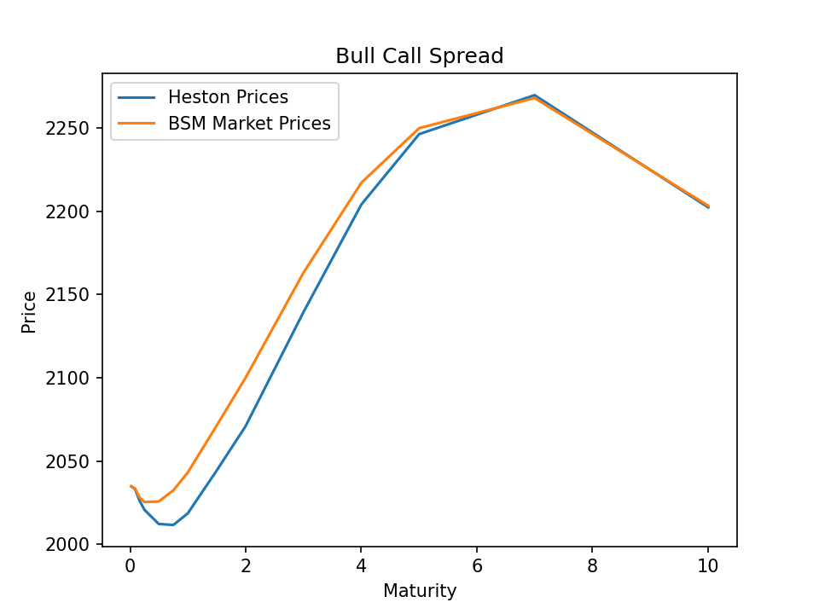
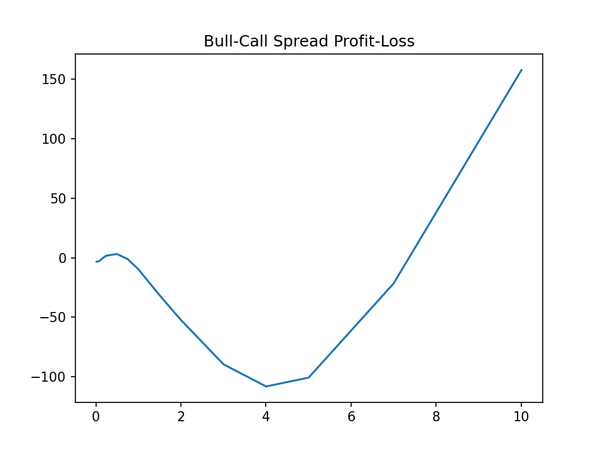
Bull-Call Spread $→$ call(low strike) - call(high strike)

Slide 37
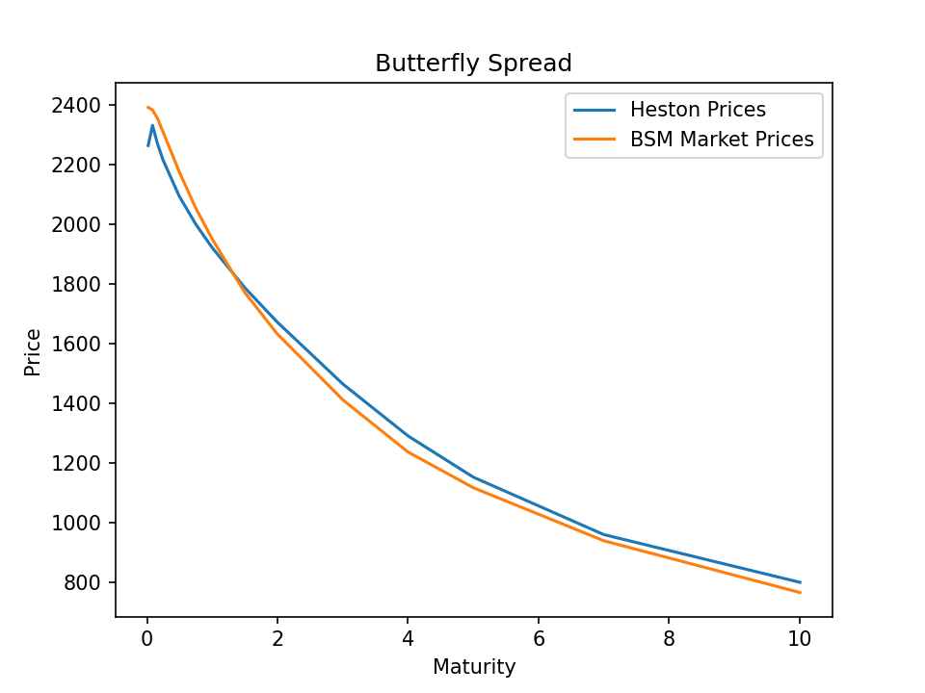
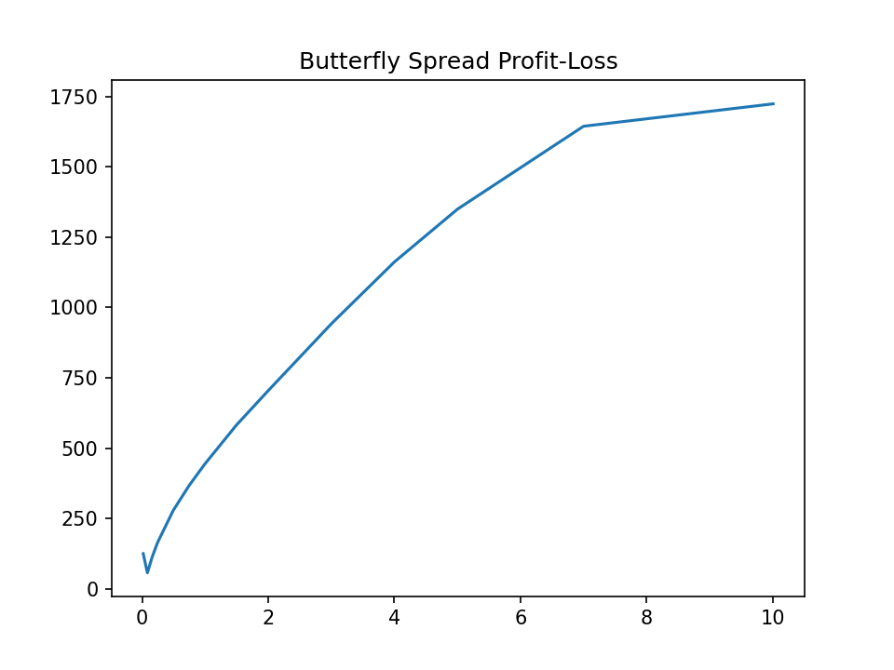
Butterfly Spread $→$ call(low strike) + call(high strike) – 2*call(written strike)
$low strike < written strike < high strike$
Best for longer maturities

Slide 38
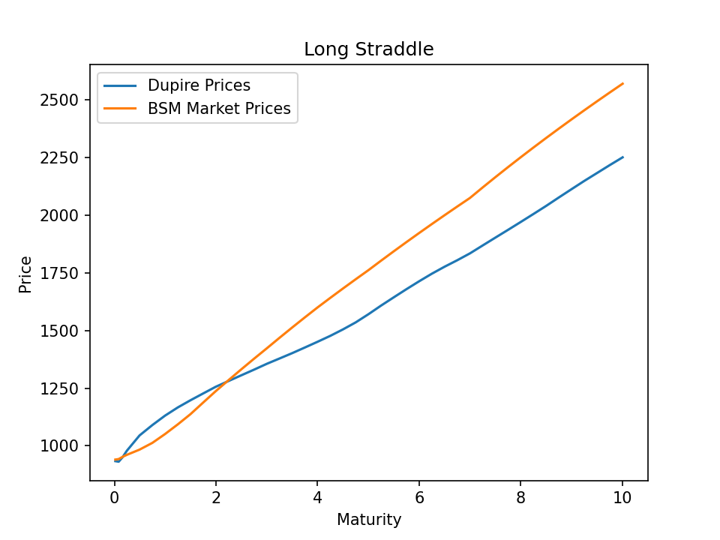
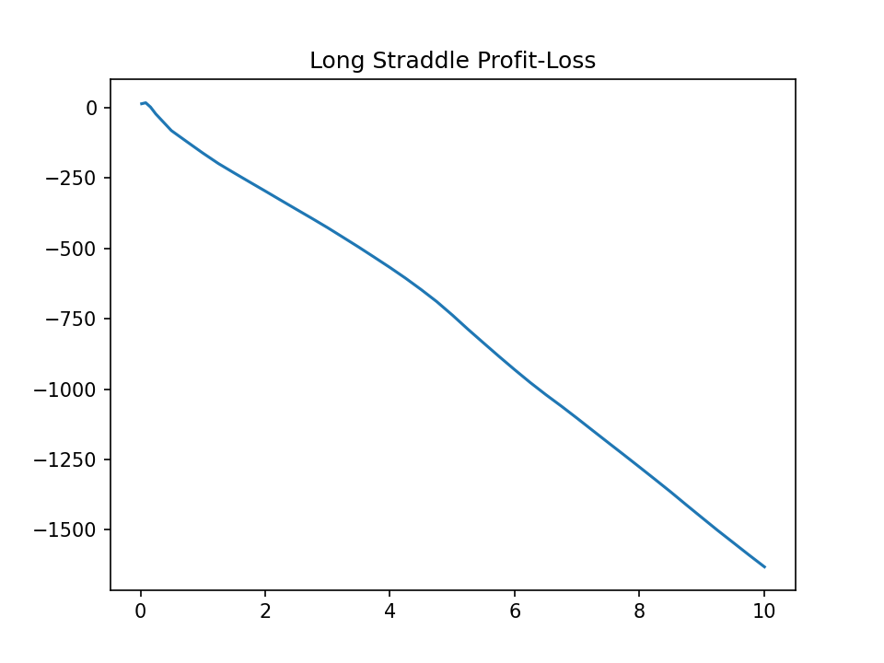
Long Straddle $→$ Call(Strike) + Put(Strike)
Worth only for shorter maturities

Slide 39
Q & A

